Slide 1
CS5223 Distributed Systems
Lecture 2: Communication
Instructor: YU Haifeng

Slide 2
Today’s Roadmap
Chapter 4 of textbook
Review (Overview) of the OSI model
Remote Procedure Call / Remote Method Invocation
If you don’t know Java, read some tutorials on Java (e.g., “Java in a Nutshell” https://www.amazon.com/Java-Nutshell-Desktop-Quick-Reference/dp/1492037257/ref=dp_ob_title_bk)
Should be quite easy if you already know C++
Multicast
Gossiping

Slide 3
Motivation
Distributed systems by definition need communication
Networking:
Aims at providing delivery of data
Does not care about the data content
Distributed systems:
The layer above networking
Does not care how the data is delivered – sometimes treat the network as a black-box
Pros and cons of treating network as a black box?
Example?
distributed systems
networking

Slide 4
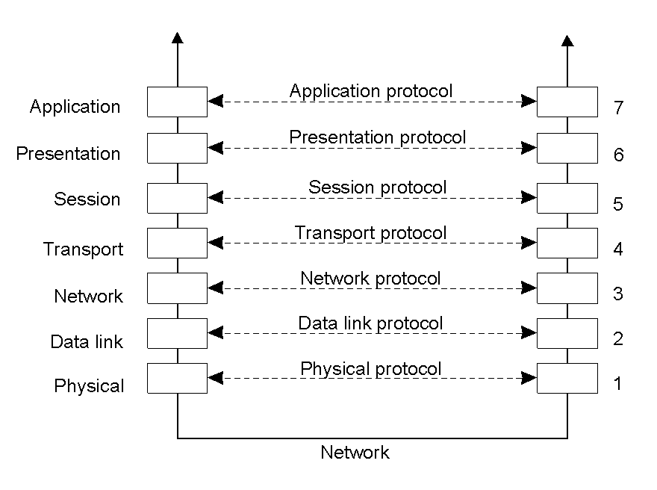
Overview (Review) of OSI Model
Open Systems Interconnection Reference Model

Slide 5
More Details on Each Layer
Physical layer
Transmission of bits between sender and receiver
Data link layer
Transmission of frames (series of bits) with error correction and detection
Network layer
Describes how packets are routed along multiple hops
Prominent example: IP (Internet protocol)

Slide 6
Transport Layer
Transport layer provides the actual communication facilities for most distributed systems
Standard Internet transport-layer protocols
TCP (transmission control protocol): Reliable, in-order, with flow control, stateful
UDP (universal datagram protocol): Unreliable (best-effort) datagram connectionless communication

Slide 7
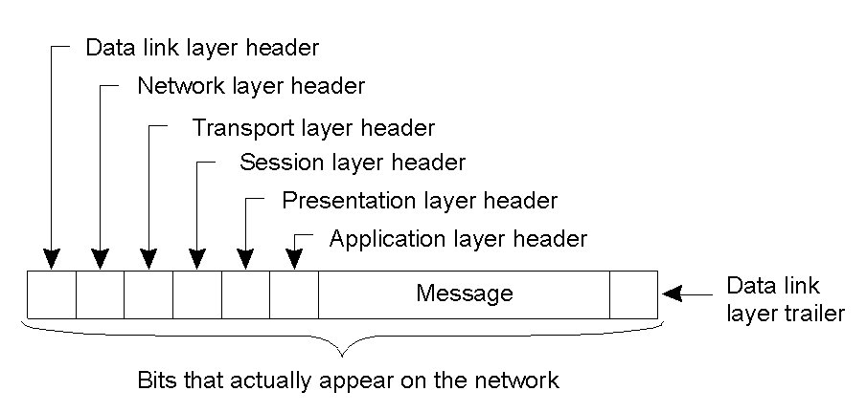
Messages in the OSI Model

Slide 8
OSI Model - Continued
The OSI model does not dictate how you implement each layer
Nothing fancy – just the application of layered modular design principle
Neither the only model nor the best model (no single best model)
But it is widely accepted – you want to speak the same language as other people
Should NOT view it as cast into stone: The layered modular design principle is more important than the model itself
OSI aims for generality, and one can also customized it in different context
Why should we customize it?
Example?

Slide 9
The concepts of Application, Presentation, and Session layers are not widely used.
Distributed Systems -- may have its own layers
Networking

Slide 10
Motivation for More Powerful Communication Mechanisms
Many distributed systems directly use TCP/UDP
Prominent examples: Distributed games, BitTorrent
In theory, all distributed systems can be built by directly using TCP/UDP
But many distributed systems share common communication pattern / requirements
Middleware / libraries / tools / modules to simplify their design
Again, just a software engineering principle (what principle?)

Slide 11
More Powerful Communication Mechanisms
Remote Procedure Call / Remote Method Invocation
Multicast
Gossiping

Slide 12
Motivation: Remote Procedure Call
Many distributed systems involve the interactions between a client and a server
Example: Clients wants to read the content of a file on a remote machine
So common that we want to develop a common middleware / library / toolkit to simply their designs
One approach (not the only approach): Remote procedure call
Example: read(fileid, buffer, numbytes)

Slide 13
Motivation: Remote Procedure Call
Sending the parameters to the remote machine and then wait for a reply
Simple (and potentially efficient) to implement
Can do so using a general middleware that work for all remote procedure calls
Why RPCs are good
Application developers are familiar with procedure calls
RPCs operate in isolation – modular design
History has proved the huge success of RPC
Java and C# have RPC support built into the language

Slide 14
Typical Architecture for Enabling RPC
Client machine
Server machine
application code
client stub
server stub
application code
return
unpack results
pack results
return
caller
callee
pack parameters
unpack parameters
call
call
OS kernel
OS kernel
NETWORK
Yellow parts are provided by the RPC mechanism

Slide 15
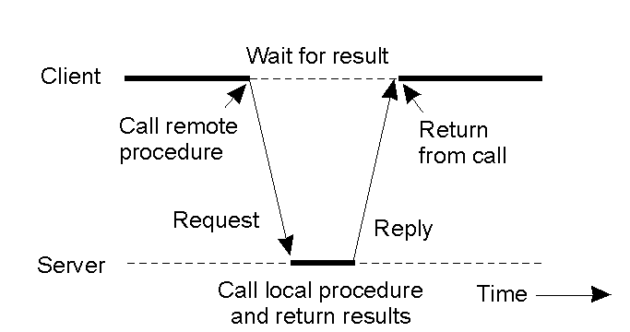
RPCs are by definition blocking

Slide 16
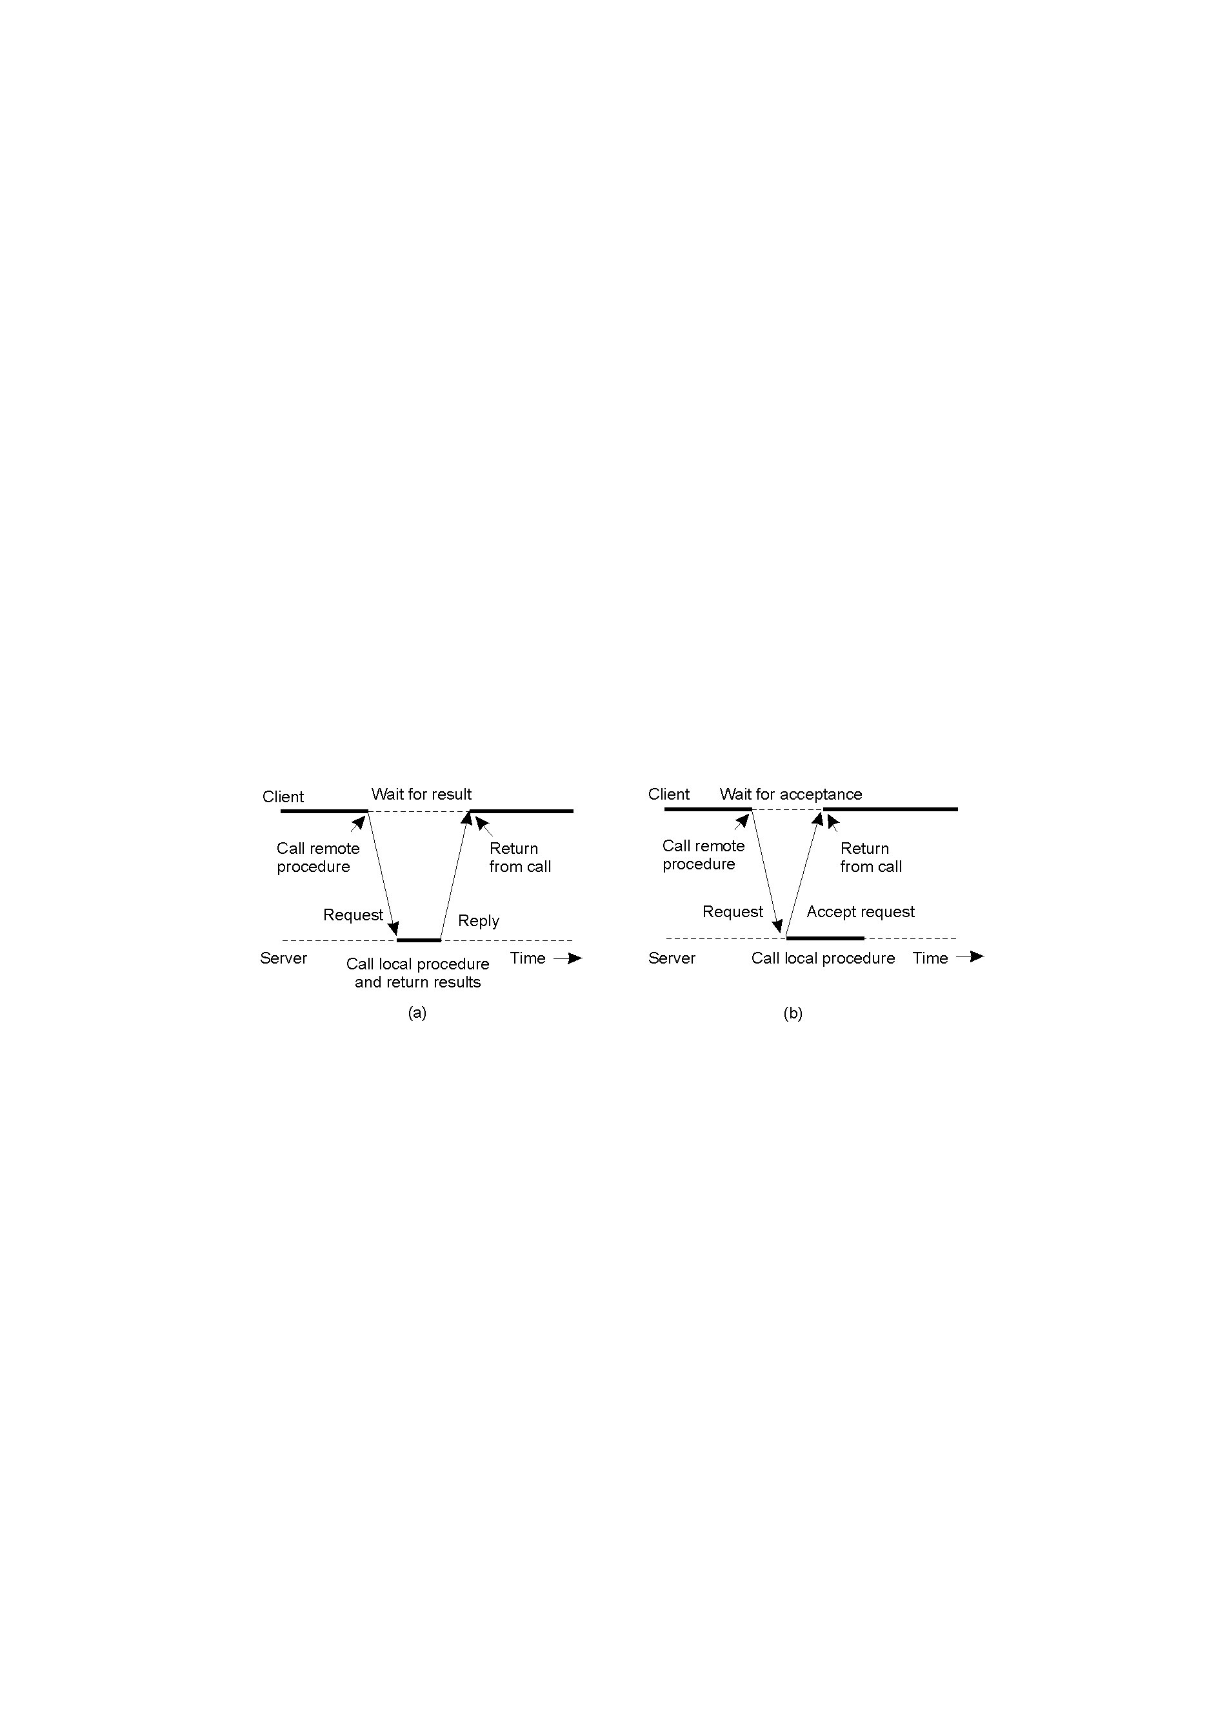
Making RPCs Non-blocking
simplest way: spawn a separate process
Non-blocking RPCs depart from procedure call semantics
If you use a lot of non-blocking RPCs, re-think whether you indeed want to use RPC

Slide 17
RMI: A Case Study for RPC
RMI is just object-oriented RPC
Each function (i.e., method) in Java belongs to some object
read(file, buffer, numbytes) ⇒ file.read(buffer, numbytes)
file is a reference to a “remote object”
We will focus on RMI as an example from now on

Slide 18
Java Remote Objects
What is needed in a remote object reference
Need to ensure uniqueness over space – no other object has the same “name”
Need to ensure uniqueness over time – no other objects should have the same “name” in the past or in the future
IP addr
port num
creation time
obj num
methods

Slide 19
Marshaling: Primitive Data Types
Marshaling: Client needs to send the parameters of the function call to the server
Wrap all parameters into a message and send the message
Network transmits raw bytes: Client and server may have different representation of data
most
significant
least
significant
least
significant
most
significant
0
0
0
5
0
0
0
5
4-byte integer on Pentium
4-byte integer on SPARC

Slide 20
Marshaling: Java (Non-remote) Objects
How to marshal complex data types (i.e., objects)
Example: A Vector of integers
Java object serialization: convert a Java object to a bit string (for sending over the network or storing on disk)
Java serialization extremely useful:
How to store a binary tree?
What about a vector of vectors?
When serializing an obj, all obj it references are serialized as well (and this goes on…how?)
Understand the object you are serializing

Slide 21
Marshaling: Java (Non-remote) Objects
Unmarshaling on server: Use de-serialization and convert the bit stream back to object
A new object will be created on server
Use of object serialization/de-serialization ⇒
Semantics of RMI is different from local method invocation
Server will work on the “cloned” object
The “clone” can then start differing from the original….

Slide 22
Marshaling: Java Remote Objects
Remote objects are passed by reference when used as parameter
C.factorize(V, F)
C is a ComputeEngine object; V is a Vector of integers, F is output file
C and F are remote objects, V is a local object
remote object F
Local Object V
remote object C
client code
server code
Copy of V
server code
can later invoke F.write(buffer)
invoke C.factorize(V, F)

Slide 23
Marshaling: Java Remote Objects
Remote objects are always “interfaces”
The remote object may originates from the client or some other server
Enables complex interactions (such as callbacks) – how?

Slide 24
Result Marshaling/Unmarshaling
Exactly the same as parameter marshaling / unmarshaling

Slide 25
Naming in Java RMI
Obtain a reference of a remote object for the first time
Server machine runs rmiregistry (a separate process from the Java process)
rmiregistry [port]
Java prog on the server invokes
Naming.rebind(“objname”, remote_obj);
rmiregistry will remember this name binding
Java prog on the client invokes
obj = Naming.lookup(“//ip_addr:port/objname”);
rmiregistry will return the remote obj
Lookup itself is like an RMI

Slide 26
Downloading of Classes
Two scenario:
Receive a marshaled object, but don’t have the code (i.e., class file) for that object
Receive a reference of a remote object, but don’t have the code (i.e., class file) for the object
Java will automatically “download” the class file from the machine where you get the object
Advantage: Allow automatic object upgrade
Disadvantage: If you already have a class file for that object, the local class file will be used – possibility of inconsistency

Slide 27
When we should NOT use RMI/RPC
RPC aims for client/server communication:
Not suitable for multicast/broadcast
Performance: Why RPC is not used for web browsing?
Sub-question: What exactly are we using for web browsing?
All about tradeoffs
Blocking: A client cannot invoke RPCs in parallel
Non-blocking RPC solves the problem, but at the cost of design complexity – sometimes beats the exact purpose of RPC!

Slide 28
When we should NOT use RMI/RPC
Failures: Perhaps the biggest vulnerability
Concept of RPC comes from local procedure call and intends to preserve its behavior
What if the server fails during execution?
Client has no idea whether the procedure has been invoked or not …example?
To ensure exactly-once semantics, careful /complex logging needs to be done
Should we hide such failure or expose it?
Again, it is about tradeoffs

Slide 29
How to make up your mind?
Rule of thumb: Use RPC if the communication pattern is simple, if you do not expect/worry much about failures, and if performance overheads are acceptable.

Slide 30
History Readings (Non-compulsory)
The original paper [Birrell and Nelson’84]:
“Implementing Remote Procedure Calls”, in ACM Transactions on Computer Systems, Feb 1984.
SUN RPC:
http://www.rfc-editor.org/rfc/rfc1057.txt
XML-RPC:
http://www.xmlrpc.com/

Slide 31
Motivation: Multicast
Single sender sends the same data to n receivers
Use n point-to-point messages
Overload the sender – throughput limited by
server’s bandwidth / n
Multicast: Have the clients help forward the message to others

Slide 32
Without Multicast
A uses its outgoing link 3 times
Edge R1→R3 is used 3 times as well
C
A
R4
R1
R3
R2
R5
B
D

Slide 33
IP-Multicast
A networking topic
Very efficient – message never traverse same link twice
Need support for routers – ISPs hate changes
IP multicast was never hugely successful – a good technique does not always turn into products
C
A
R4
R1
R3
R2
R5
B
D

Slide 34
Application-Level Multicast
Example: Server sends data to a small number of client, each client forwards the data to some other clients
A distributed system topic
C
A
R4
R1
R3
R2
R5
B
D

Slide 35
Application-Level Multicast
Advantage:
Partly solves the problem with server bandwidth
No need to change routers
Disadvantage:
A message may still traverse the same link twice
Overall: Has been much more successful than IP multicast
C
A
R4
R1
R3
R2
R5
B
D

Slide 36
Designing Application-Level Multicast
Multicast topology
A
B
C
D
C
A
R4
R1
R3
R2
R5
B
D

Slide 37
Multicast Topology
Tree: Simple but not robust
Mesh: Robust but more complex – what data should I get from whom?
A
B
C
D
F
E
G
A
B
C
D
F
E
G

Slide 38
Designing Application-Level Multicast
Quality of a multicast tree
Link stress (2): maximum # messages traversing the same edge
Stretch (12/4=3): Relative delay penalty given a pair of nodes
Tree cost (12): Total weight of edges – minimum spanning tree optimizes for tree cost
C
A
R4
R1
R3
R2
R5
B
D

Slide 39
Motivation: Gossip
Sender wants to send the same data to multiple receivers
Each node periodically send the data (if it has the data) to some other random node – usually called a round
Advantage of gossip:
Reduces load of the sender
Extremely robust
Easy to verify from our everyday experience
Simple – no need to maintain a multicast topology
Disadvantage – not as efficient as multicast

Slide 40
Designing a Gossip Protocol
Each gossip operation is between two nodes
How to pick the other node to gossip with?
Usually picked uniformly at random
How to pick random nodes without global knowledge?
Performance will be influenced by the choice
How to gossip? If P picks Q
P may gossip news to Q (push)
P may request news from Q (pull)
P and Q may update each other (push+pull)

Slide 41
Performance of Push-based Gossiping
P pushes message to Q
Effective at the beginning, but not toward the end
Chance of a black P picking a white Q decreases with time
n: # total nodes; b: # black nodes;
Prob[a black P picks a white Q] = (n-b)/n = 2/7
But the number of black P’s increases as well !
(Description on textbook is not complete)
round r
n = 7 and b = 5
round r+1

Slide 42
Push: Be More Rigorous
Consider a white node Q at round r
Prob[Q remains white at round r+1] is
Changing the last remaining white node to black (i.e., from b = n-1 to b = n)
On expectation 1/0.63 = 1.6 rounds needed
Changing the first remaining white node to black (i.e., from b = 1 to b = 2)
On expectation round needed

Slide 43
Performance of Pull-based Gossiping
P pulles message to Q
Not effective at the beginning, but effective toward the end
Chance of a white P picking a black Q increase with time
n: # total nodes; b: # black nodes;
Prob[a white P picks a black Q] = b/n = 5/7
round r
n = 7 and b = 5
round r+1

Slide 44
Pull: Be More Rigorous
Changing the first remaining white node to black (i.e., from b = 1 to b = 2)
On expectation 1.6 rounds needed – why?
Changing the last remaining white node to black (i.e., from b = n-1 to b = n)
On expectation round needed
One would naturally imagine that we want to use push+pull

Slide 45
Asymptotic Properties
The asymptotic number of rounds needed to change all nodes to black is the same:
For push-only
For pull-only
For push+pull
To prove this, consider two stages:
First stage: From b = 1 to b = 0.1n
Second stage: From b = 0.1n to b = n

Slide 46
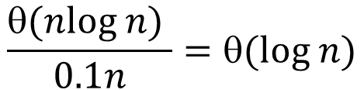

Second Stage
At each round, imagine that the black nodes each throws a ball into a uniformly random bin (this is for push – pull is slightly different)
Total 0.1n balls thrown into n bins
The number of balls thrown at each round never below 0.1n
Coupon collection problem tells us:
On expectation needs balls
Thus on expectation, # rounds needed is at most
$$(nlog n)$$
$$\frac{θ(nlog n) }{0.1n}=θ(log n)$$

Slide 47
First Stage
Define to be # rounds needed from b = 1 to b = 2
Define to be # rounds needed from b = 2 to b = 4
…
Can prove that E[ ] < 1.3 for all i
Thus the first stage takes rounds on expectation
Need b successes. Each ball has a success probability of at least (n-b)/n ≥ 0.8.
Need on expectation b/0.8 < 1.3b balls. Each round has at least b balls. Need on expectation < 1.3 rounds.
b
n-b
2b

Slide 48
History Readings (Non-compulsory)
The original paper on gossiping:
“Epidemic Algorithms for Replicated Database Maintenance” in PODC’87
http://portal.acm.org/citation.cfm?id=41841

Slide 49
More Applications of Gossiping
Gossiping not only good for propagating messages
Another interesting application: Information aggregation
Count the total number of nodes in the system
A distinguished node 0 starts from a value
Others have
Each node i periodically picks another node j
Node i: new
Node j: new

Slide 50
Counting the Number of Nodes
Eventually all nodes will have the same values
Property from how we update : Mass preserving
The sum of all ’s are always 1
Property from gossiping:
All ’s will eventually be the same
Takes logarithmic number of rounds to achieve this (a much harder proof!)
Number of nodes =

Slide 51
Computing Average
Each node has a value (e.g., available disk space)
We want to know the total available disk space
Same as before but set to be the amount of disk space available
What if we want to compute sum?
Drawback of this approach: Node leaves and node failures
Disrupts the mass preserving property – any way to patch?

Slide 52
Another Way of Computing Count
Each node picks a random number between [0,1]
Use gossiping to find out the minimum
(The textbook uses maximum, which is the same – but conventionally people use minimum)
The larger the number, the smaller the minimum
How to do sum and average?
Advantage: More robust against failures
Other in-depth differences with the previous approach exist (e.g., specific forms of the asymptotic properties)

Slide 53
History Readings (Non-compulsory)
The beautiful push-sum algorithm
“Gossip-based Aggregation in Large Dynamic Network”
http://portal.acm.org/citation.cfm?id=1082470

Slide 54
Summary
Review (Overview) of the OSI model
Remote Procedure Call / Remote Method Invocation
If you don’t know Java, real some toturials on Java
Multicast
Gossiping

Slide 55
Mandatory Homework For This Week
Try out RMI by following tutorial at
LumiNUS\CS5223\Files\RMITutorial
You should be able to smoothly run and completely understand this example, otherwise you will have trouble with Assignment One
Email me or the TA (Kiran, e0427802@u.nus.edu) if you need help on this homework --- everyone should complete this homework
Resources:
Student discussion forum on LumiNUS -- You are encouraged to discussed with other students about this homework
Security warning – kill your processes after running:
Do not leave rmiregistry running forever
Do not leave your server code running forever

